Slide 1
Language Modeling with N-grams
정보통신공학과 이승호

Slide 2
CONTENTS
N-Grams
Evaluating Language Models
Generalization and Zeros
Smoothing
Kneser-Ney Smoothing

Slide 3



N-grams
Sequence of N words
  2-gram(or bigram) – two-word sequence of words like “please turn”, “turn your”, “your homework”
  3-gram(or trigram) – three word sequence of words like “please turn your”, “turn your homework”
How to use N-gram models to estimate the probability of the last word of an N-gram

Slide 4





Approximate using bigrams

Slide 5

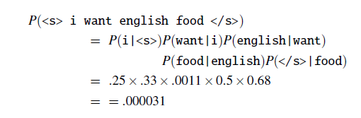
Example

Slide 6
Evaluating Language Models

Slide 7
Extrinsic evaluation
The best way to evaluate the performance of a language model
To know if a particular improvement in a component is really going to help the task

Slide 8
Instrinsic evaluation
Running big NLP systems end-to-end is often very expensive
Used to quickly evaluate potential improvements in a language model

Slide 9
Train Test Held-out
If test sentence is part of the training corpus, it will mistakenly assign it an artificially high probability when it occurs in the test set.
It called “Training on the test set.”

Slide 10
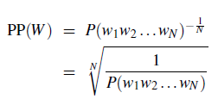

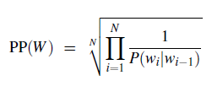
Perplexity
정보이론에서 확률모델이 샘플들을 얼마나 잘 예측하는지를 측정하는 지표
확률 모델이 샘플들을 잘 예측할수록 perplexity가 낮아진다.

Slide 11
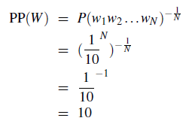
Weighted average branching factor
Branching factor
다음 단어로 나올 수 있는 단어들의 개수
단어 시퀀스 10개가 구성될 확률
Weighted average branching filter
If number zero is really frequent and occurs 10 times more often than other numers? → perplexity will be smaller

Slide 12

Perplexity of N-gram Model
The more information the N-gram gives us about the word sequence
The lower the perplexity.

Slide 13
Generalization and Zeros

Slide 14
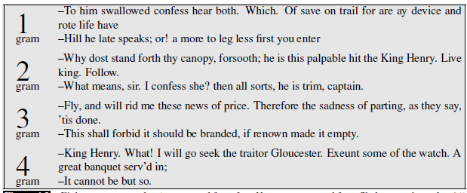
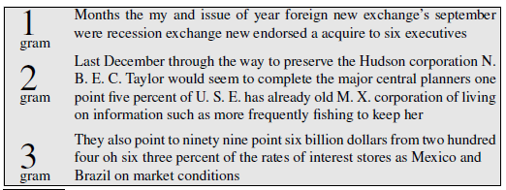
Generalization

Slide 15
Zeros
Don’t ever occur in the training set but do occur in the test set
If the probability of any word in the test set is 0, the entire probability of the test set is 0.
We can’t compute perplexity at all, because we can’t divide by 0

Slide 16
Unknown words
If we know all the words in advanced
  Vocabulary V is fixed
  Closed vocabulary task
Often we don’t know this
  Out Of Vocabulary = OOV words
  Open vocabulary task
Instead: create an unknown word token <UNK>
  Training of <UNK> probabilities
    Create a fixed lexicon L of size V
    At text normalization phase, any training word not in L changed to <UNK>
    Now we train its probabilities like a normal word
  Reduce lower frequency words
    Replace by <UNK> all words that occur fewer than n times in the training set

Slide 17
Smoothing

Slide 18
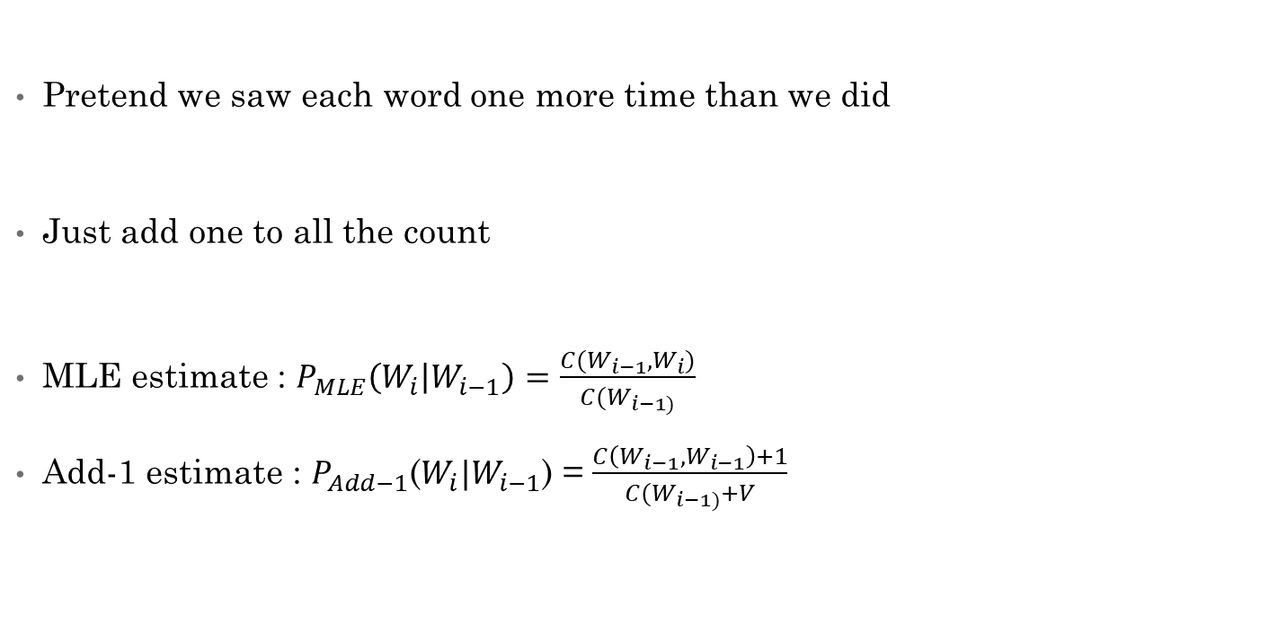
Laplace(Add-One) Smoothing
Pretend we saw each word one more time than we did
Just add one to all the count
MLE estimate : $P_{MLE}\left(W_{i} | W_{i−1}\right)=\frac{C(W_{i−1},W_{i})}{C(W_{i−1)}}$
Add-1 estimate : $P_{Add−1}$($W_{i}|W_{i−1}$) = $\frac{C\left(W_{i−1},W_{i−1}\right)+1}{C(W_{i−1)}+V}$

Slide 19
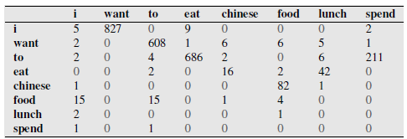
BRC : biram counts

Slide 20
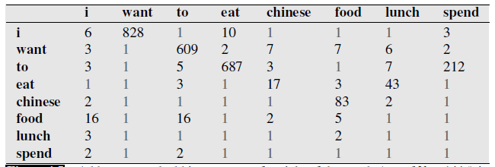
BRC : Laplace smoothed bigram counts

Slide 21
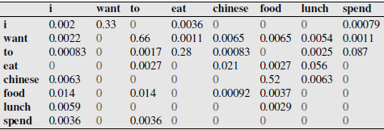
BRC Probability

Slide 22
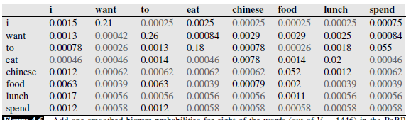
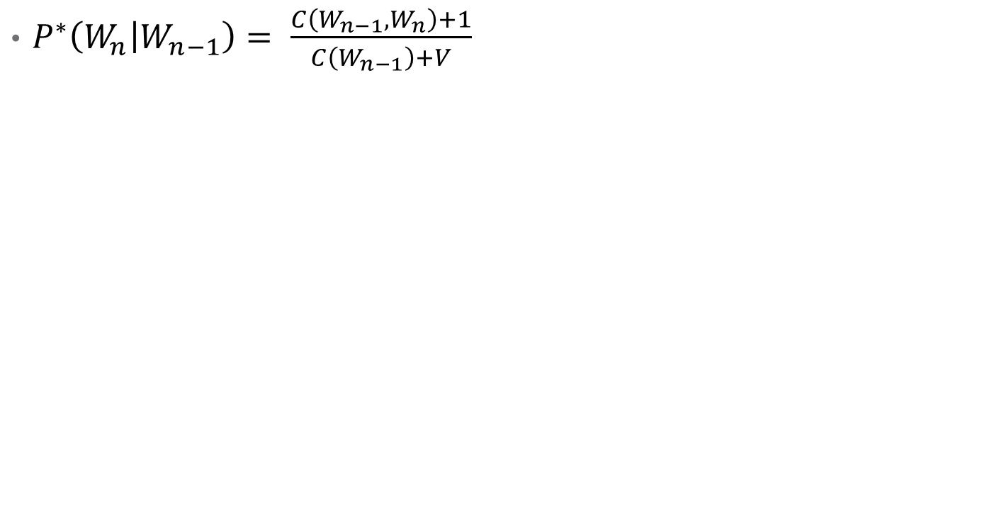
Laplace-smoothed bigrams
$P^{∗}\left(W_{n} | W_{n−1}\right)= \frac{C\left(W_{n−1},W_{n}\right)+1}{C\left(W_{n−1}\right)+V}$

Slide 23
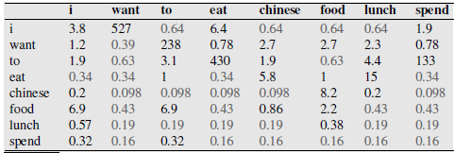


Reconstituted counts
$C^{∗}(W_{n−1},W_{n)= }\frac{\left[C\left(W_{n−1},W_{n}\right)+1\right]∗C(W_{n−1})}{C\left(W_{n−1}\right)+V}$

Slide 24
Backoff and Interpolation
Sometimes it helps to use less context
  Condition on less context for contexts you haven’t learned much about
Backoff
  Use trigram if you have good evidence,
  otherwise, bigram, otherwise unigram
Interpolation
  Mix unigram, bigram, trigram…
Interpolation works better

Slide 25
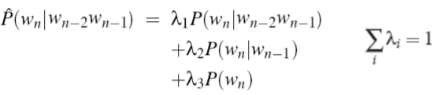
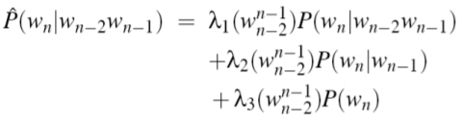
Linear Interpolation
Simple interpolation
Lambdas conditional on context

Slide 26
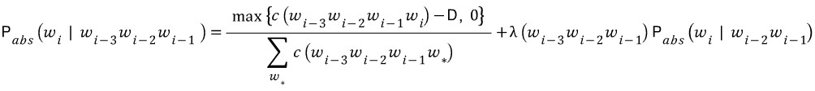

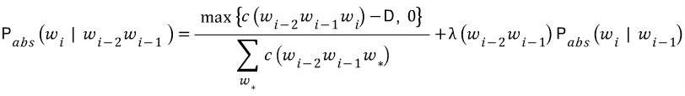

Absolute discounting interpolation

Slide 27
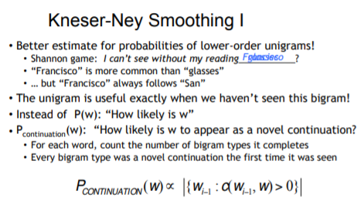
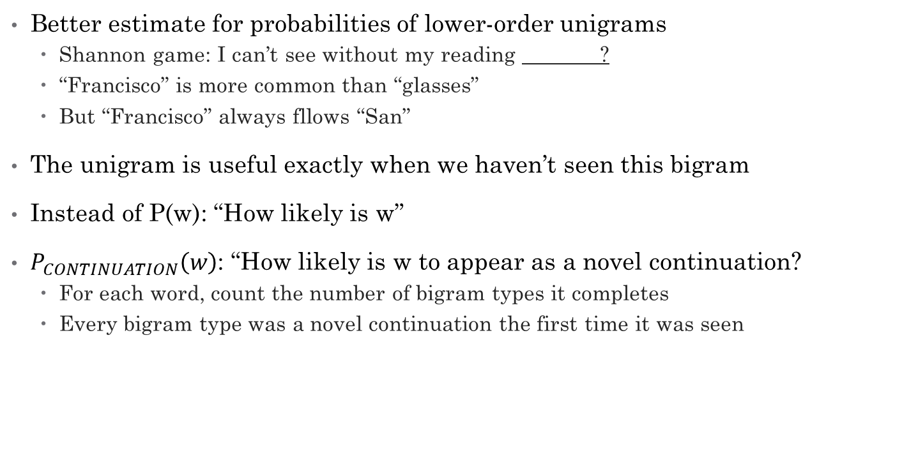
Kneser-Ney Smoothing 1
Better estimate for probabilities of lower-order unigrams
  Shannon game: I can’t see without my reading ?
  “Francisco” is more common than “glasses”
  But “Francisco” always fllows “San”
The unigram is useful exactly when we haven’t seen this bigram
Instead of P(w): “How likely is w”
$P_{CONTINUATION}\left(w\right)$: “How likely is w to appear as a novel continuation?
  For each word, count the number of bigram types it completes
  Every bigram type was a novel continuation the first time it was seen

Slide 28
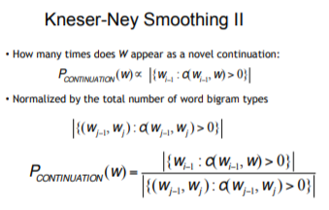
Kneser-Ney Smoothing 2
How many times does W appear as a novel continuation:
Normalized by the total number of word bigram types

Slide 29
